Slide 1

]
AUTOML
CLASSIFIER

Slide 2

GROUP MEMBERS:
B45-SHAH MOKSHA
B47-SHAH PRITESH
B61-TANNA KHUSHI
B67-THANKI HIMANI

Slide 3
Automated Machine learning
Automated machine learning (AutoML) find the right algorithm and hyperparameters in a data driven way without any human intervention.

Slide 4
Auto ML Benefits
Auto ml allows the data scientist to extend his productivity without adding more members to the data science team.
Auto ml addresses the skills gap between the demand for data science talent and the availability of this talent.

Slide 5
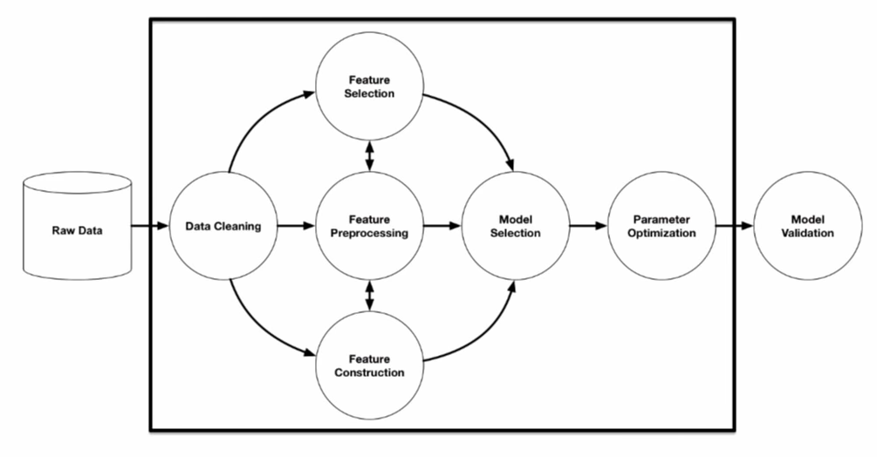
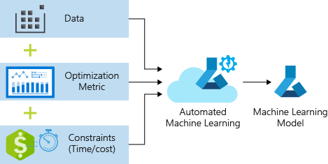
Auto ML aims to automate the entire ML workflow

Slide 6
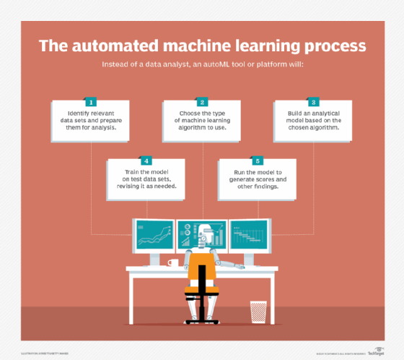
AUTOML PROCESS

Slide 7
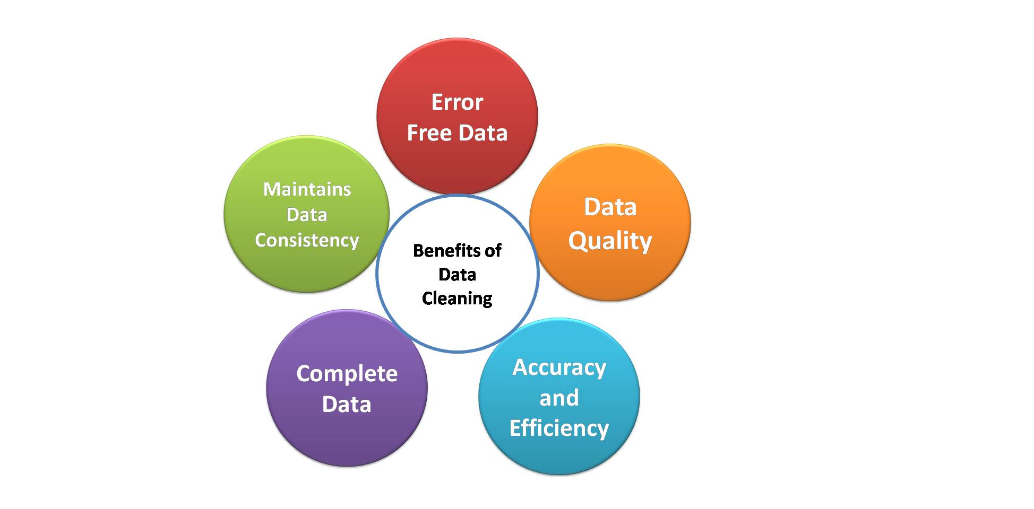

Benefits of Data Cleaning

Slide 8
Types of AutoML
Automated feature engineering
Automated model selection and hyperparameter tuning
Automated neural network architecture selection

Slide 9
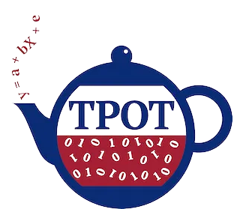



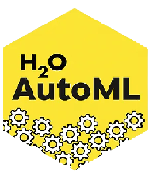


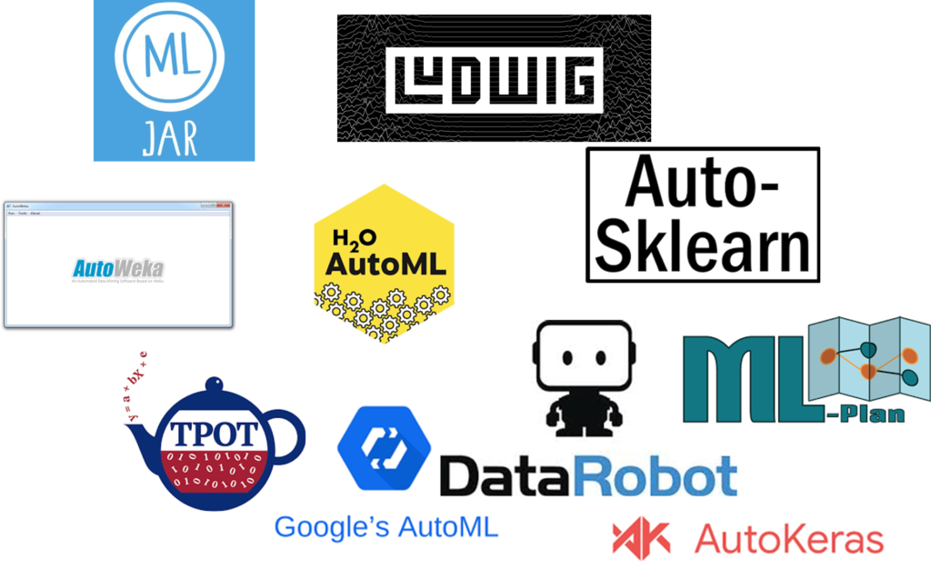
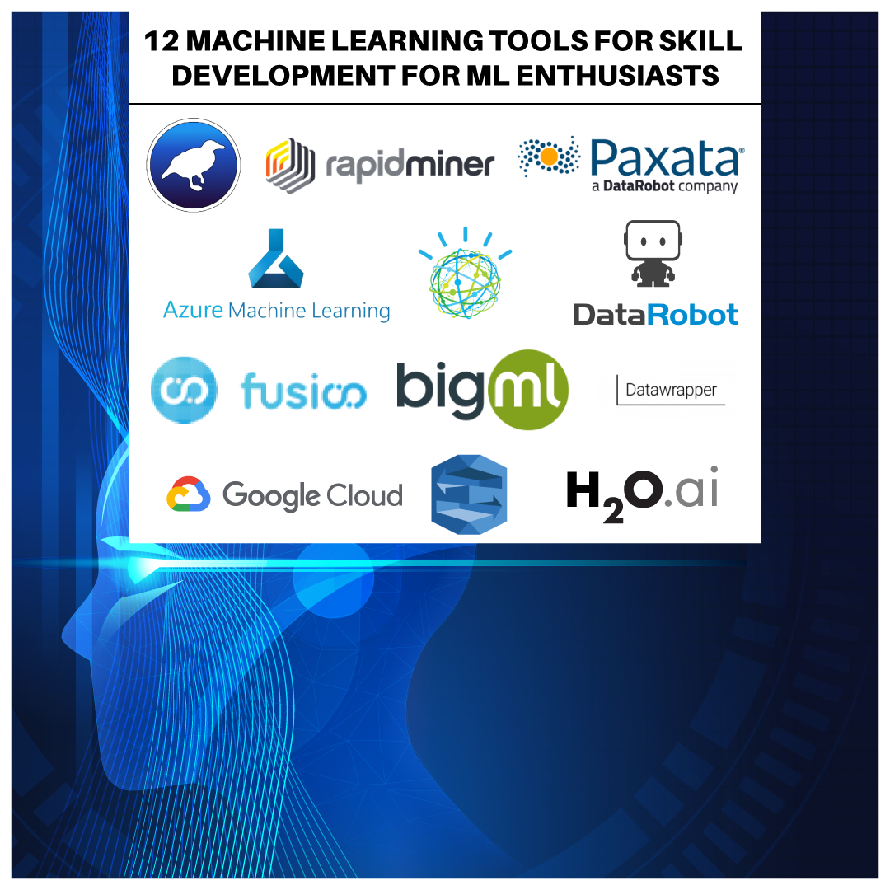
AUTOMATED ML TOOLS
Tools

